Slide 1
Discussion on General Observations Class – Event Class
Anagha Bhatkhande/Varsha Mahajan
V 01
Effective date: 26-Oct-2017Y
Copyright © 2016 Tata Consultancy Services Limited
Notes:
Title Slide
Theme Image area
We need to place appropriate image based on the content of the Presentation
Version No
Release date
PALS logo
TCS logo
Theme 1-a
Align text to the bottom of the logo bottom line
Font size 10pt

Slide 2


Confidentiality Statement
This document contains information which is commercially confidential to Tata Consultancy Services Ltd. ("TCS") and is provided for the sole purpose of permitting the recipient to evaluate the proposal submitted within the document. In consideration of the receipt of this document, the recipient agrees to maintain the information it contains in confidence and not to reproduce or otherwise disclose the contents of this document to any person outside the recipient's evaluation team or nominated advisors. The document may not be used, reproduced or disclosed to others, except as specifically permitted by TCS in writing. The recipient of this document, by its retention and use, agrees to take reasonable endeavours to protect the document and the information it contains from loss or theft.
© 2017 - TATA Consultancy Services Limited (TCS)
TCS confidential

Slide 3
Agenda/Content
Overview of General Observations Class
Example from EVENTS class

Slide 4
Overview of General Observations Class
General Observations class : Subject-level observations captured during the study
Classified as Interventions, Events, or Findings
INTERVENTION CLASS :- (1) Data of investigational treatment as specified by the study protocol
(2) Therapeutic and other treatments coincident with the study assessment period (e.g.,
concomitant medications
(3) Self-administered by the subject (such as use of alcohol, tobacco, or caffeine).
EVENT CLASS:- (1) Planned protocol milestones : randomization , study completion, occurrences, conditions
(2) Occurrences of unplanned events (Adverse Events)
(3) Incidences prior to trial (Medical History)
Concomitant Medications (CM)
Exposure as Collected (EC)
Exposure (EX)
Substance Use (SU)
Procedures (PR)
Adverse Events (AE)
Clinical Events (CE)
Disposition (DS)
Protocol Deviations (DV)
Healthcare Encounters (HO)
Medical History (MH)
TCS confidential

Slide 5
Overview of General Observations Class(Contd…)
FINDINGS CLASS :- (1) Observations storing results of Tests based on planned/unplanned evaluations
(e.g. laboratory tests, ECG testing, and questions listed on questionnaires)
Drug Accountability (DA)
Death Details (DD)
ECG Test Results (EG)
Inclusion/Exclusion Criterion Not Met (IE)
Immunogenicity Specimen Assessments (IS)
Laboratory Test Results (LB)
Microbiology Specimen (MB)
Microscopic Findings (MI)
Morphology (MO)
Microbiology Susceptibility Test (MS)
PK Concentrations (PC)
PK Parameters (PP)
Physical Examination (PE)
Questionnaires (QS)
Reproductive System Findings (RP)
Disease Response (RS)
Subject Characteristics (SC)
Subject Status (SS)
Tumor Identification (TU)
Tumor Results (TR)
Vital Signs (VS)
TCS confidential

Slide 6
Adverse Event SDTM
Adverse Event :- any untoward medical occurrence in a patient or clinical investigation subject administered a pharmaceutical product and which does not necessarily have to have a causal relationship with this treatment" (ICH E2A)
Scope of adverse event collection (pre-treatment events related to trial conduct, post treatment AEs, not collecting events that are assessed as efficacy endpoints) can be decided In consultation with regulatory authorities.
May be captured either as free text or via a pre-specified list of terms.
The events included in the AE dataset should be consistent with the protocol requirements.
TCS confidential

Slide 7
Example
Subject XYZ-001-003 had eruption of skin from 10Oct2017 to 12Oct2017 which was related to the study treatment and it was severe
Information of Interest
Subject: XYZ-001-003
Untoward medical condition : eruption of skin
Start date: 10Oct2017
End date:12Oct2017
Related to study medication
Gradually became Severe
TCS confidential

Slide 8
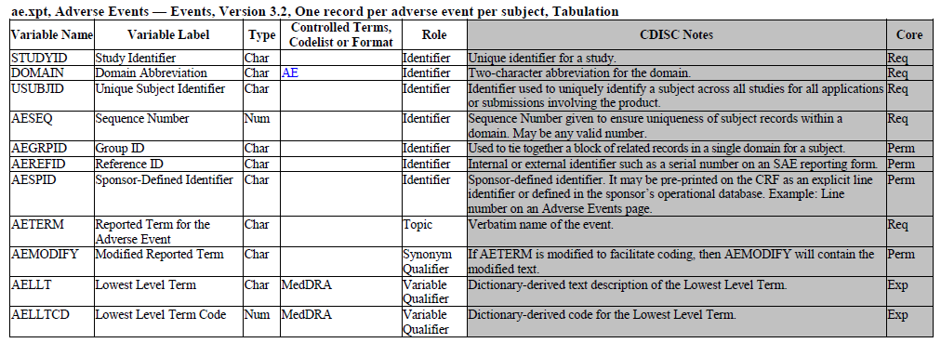
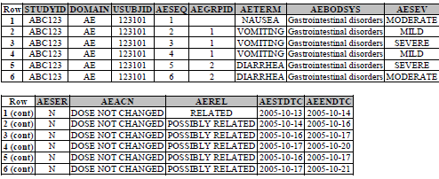
AE SDTM METADATA
Unique identifier
In this example USUBJID= XYZ-001-003
verbatim term collected for the event.
In this example AETERM= eruption of skin
Topic variable
Required variable : Can not have a null value
In this example AEMODIFY=RASH
TCS confidential

Slide 9
MedDRA Structure
MedDRA Hierarchy
System Organ Class
Gastrointestinal disorder
High Level Group Term
Gastrointestinal signs and symptoms
High Level Term
Nausea and vomiting symptoms
Preferred Term
Nausea
Lowest Level Term
Feeling queasy
TCS confidential
Notes:
MedDRA : Developed by ICH* in 1990
Highly specific standards of medical terminology
Updated twice a year
Useful for analysis as it codes the data into standard form
Standardized MedDRA Queries (SMQs) help in identification and retrieval of safety data.
The SMQs are maintained with each release of MedDRA by the MSSO.
Non-current terms are flagged at the LLT level within MedDRA
Not recommended for continued use Not recommended for continued use
Retained within the terminology to preserve historical data for retrieval and analysis
Terms that are vague, ambiguous, out dated, truncated, or misspelled
Terms derived from other terminologies that do not fit MedDRA rules

Slide 10
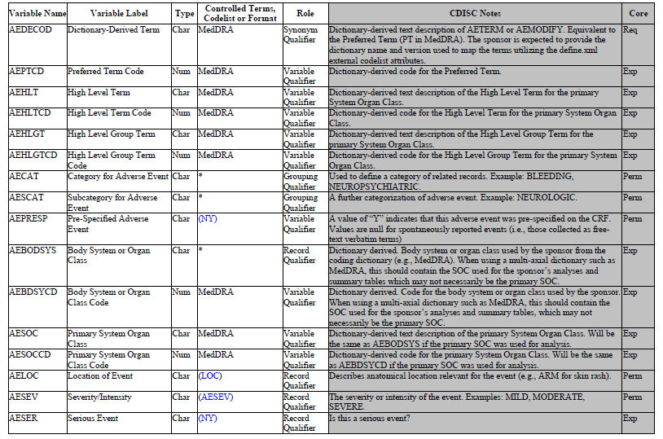
AE SDTM METADATA (contd…)
Preferred term using coding dictionary
Required Variable: Can not be missing
This is what we discussed in MedDRA
From coding dictionary associated with the adverse event by the sponsor
AE Severity
TCS confidential

Slide 11
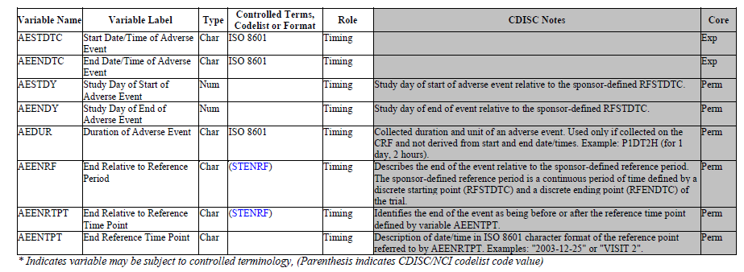
AE SDTM METADATA (contd…)
AE start and End date
TCS confidential

Slide 12
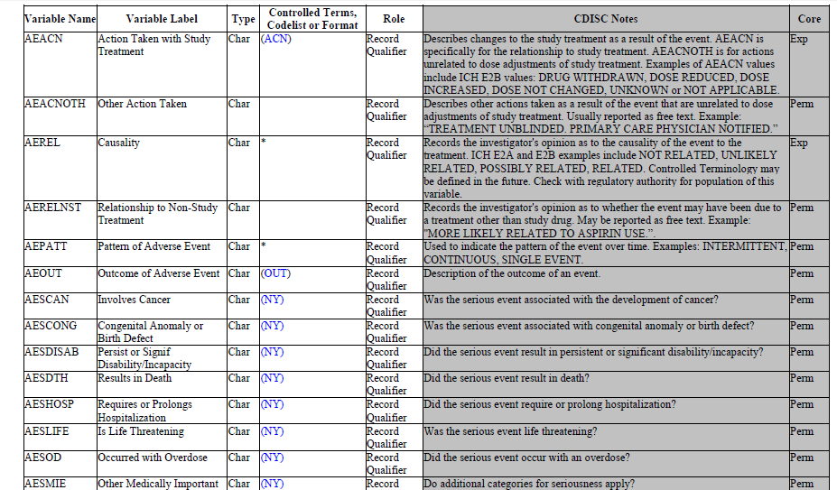
AE SDTM METADATA (contd…)
AE Related to Study medication
Final Toxicity Grade
TCS confidential

Slide 13
NCI COMMON TERMINOLOGY CRITERIA for AE
The NCI Common Terminology Criteria for Adverse Events : Descriptive terminology for Adverse Event (AE) reporting.
Grade refers to the severity of the AE.
A grading (severity) scale is provided for each AE term.
The CTCAE displays Grades 1 through 5 with unique clinical descriptions of severity for each AE based on this general guideline
Grade 1: Mild; asymptomatic or mild symptoms; clinical or diagnostic observations only; intervention not indicated.
Grade 2: Moderate; minimal, local or noninvasive intervention indicated; limiting age-appropriate instrumental ADL*.
Grade 3: Severe or medically significant but not immediately life-threatening; hospitalization or prolongation of hospitalization indicated; disabling; limiting self care ADL**.
Grade 4 : Life-threatening consequences; urgent intervention indicated.
Grade 5 : Death related to AE. (AETOXGR can have values from Grade1 to Grade 4, Death due to AE is not reported in AETOXGR, it will be captured in DISPOSITION SDTM with Reason for Death as Adverse Event)
URL for the guidance document: https://evs.nci.nih.gov/ftp1/CTCAE/CTCAE_4.03_2010-06-14_QuickReference_5x7.pdf
TCS confidential
Notes:
An AE is a term that is a unique representation of a specific event used for medical documentation and scientific analyses.

Slide 14
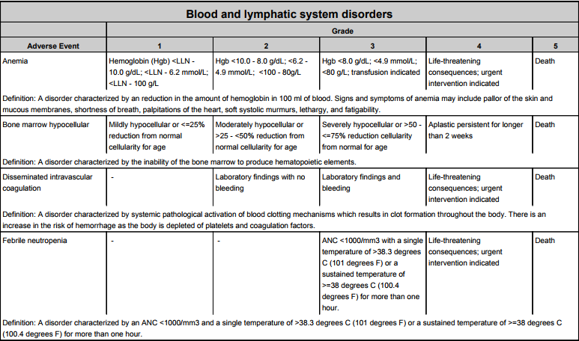
SNAPSHOT of GRADES from NCI CTC AE guideline
TCS confidential

Slide 15
Example
Subject XYZ-001-003 had eruption of skin from 10Oct2017 to 12Oct2017 which was related to the study treatment and it was severe
Information of Interest
Subject: XYZ-001-003 USUBJID
Untoward medical condition : eruption of skin AETERM, AEMODIFY=RASH
Start date: 10Oct2017 AESTDTC
End date:12Oct2017 AEENDTC
Related to study medication AEREL
Gradually became Severe AESEV
TCS confidential

Slide 16
AE Data Snapshot
Synonym
Qualifier
Topic
Variable
Timing Variable
STUDYID | SUBJID | USUBJID | AETERM | AESTDTC | AEENDTC | AEDECODE | AEMODIFY | AEBODSYS | AEREL | AESEV
XYZ | 003 | XYZ-001-003 | Eruption in skin | 2017-10-10 | 2017-10-12 | Rash | Rash | Skin and Subcutaneous tissue disorder | RELATED | SEVERE
Record Qualifier
TCS confidential

Slide 17
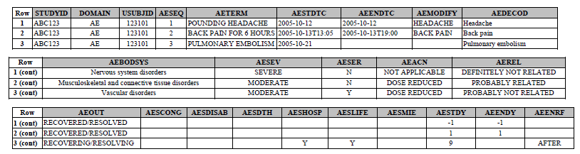
EXAMPLE 2
This is an example of data from an AE CRF that collects AE terms as free text. The first study drug was administered to the subject on October 13, 2006 at 12:00. Three AEs were reported. AEs were coded using MedDRA, and the sponsor’s procedures include the possibility of modifying the reported term to aid in coding.
Modified Term for Reporting purpose
Verbatim Term
Decoded as per MedDRA Dictionary
TCS confidential

Slide 18
EXAMPLE 3
This is an example of data from an AE CRF that collects AE terms as free text. The first study drug was administered to the subject on October 13, 2006 at 12:00. Three AEs were reported. AEs were coded using MedDRA, and the sponsor’s procedures include the possibility of modifying the reported term to aid in coding.
The CRF is structured so that seriousness category variables (e.g., AESDTH, AESHOSP) are checked only when AESER is answered “Y.”
TCS confidential

Slide 19
AE STRUCTURE
The structure of the AE domain is one record per adverse event per subject.
You may submit one record that covers an adverse event from start to finish
A patient may have multiple AE records with changes in severity, causality, seriousness and outcome
These records can be “Collapsed” into a single AE record showing highest level of severity, causality etc.
OR
You may submit a new record when severity, causality, or seriousness changes or worsens.
One record per adverse event per subject per changing severity, causality etc
Individual record in above case, Indicates that each record is considered to represent a different event.
TCS confidential
Notes:
The submission dataset structure may differ from the structure at the time of collection. E.g. You may collect data at each visit in order to meet operational needs, but submit records that summarize the event and report the highest level of severity, causality, seriousness etc.

Slide 20
AE Assumptions
Both Spontaneous and pre-specified AEs can be included in this dataset.
Records for only those events which occurred should be included in AE.
CRF data that capture adverse events either as free text or a pre-specified list of terms should be included
AETERM captures the verbatim term collected for the event and is the topic variable for the AE dataset. AETERM is a required variable
AEMODIFY is a permissible variable and should be included if the sponsor's procedure permits modification of a verbatim term for coding and AEDECOD is the preferred term and AEBODSYS is the primary system organ class derived by the sponsor from the coding dictionary.
AECAT and AESCAT are intended for categorizations that are defined in advance and should not be used for after-the-fact categorizations such as clinically significant.
AEENDTC or AEENRF should not both be populated.
If adverse events are collected more than once within the CRF (indicating that the data are visit-based), then VISITNUM is expected. If the adverse events are collected only once within the CRF (indicating that the data are event-based), then VISITNUM is permissible. VISITDY and VISIT are always permissible.
Pre-specified AEs which do not occur are not included in AE dataset.

Slide 21
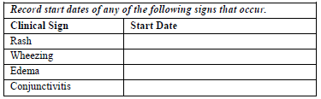
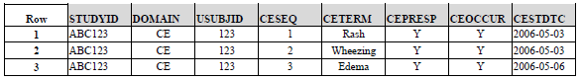
Example
CRF data are collected about pre-specified events that, in the context of this study, are not reportable as Adverse Events.
The data being collected includes ―event-like‖ timing and other Qualifiers.
Data are collected about pre-specified clinical events in a log independent of visits, rather than in a visit-based CRF module.
Note that data collected is the start date of the event, which is ―event-like‖ data.
No "yes/no" data on the occurrence of the event is collected.

Slide 22
CE Structure
One record per event per subject
Key Variables: STUDYID, USUBJID, CETERM
The intent of the domain model is to capture clinical events of interest that would not be classified as adverse events. The data may be data about episodes of symptoms of the disease under study (often known as signs and symptoms), or about events that do not constitute adverse events in themselves, though they might lead to the identification of an adverse event.
Examples:
In a study of an investigational treatment for migraine headaches, migraine headaches may not be considered to be adverse events per protocol.
The event leading to death would be reported in AE and death would also be a reason for study discontinuation in DS.

Slide 23
CE Assumptions
CEOCCUR and CEPRESP are used together to indicate whether the event in CETERM was pre-specified, and whether it occurred.
CEPRESP can be used to separate records that correspond to probing questions for pre-specified events from those that represent spontaneously reported events, while CEOCCUR contains the responses to such questions.
Relative timing assessments "Prior" or ―Ongoing‖ are common in the collection of Clinical Event information.
CESTRF or CEENRF may be used when this timing assessment is relative to the study reference period for the subject represented in the Demographics dataset (RFENDTC).

Slide 24
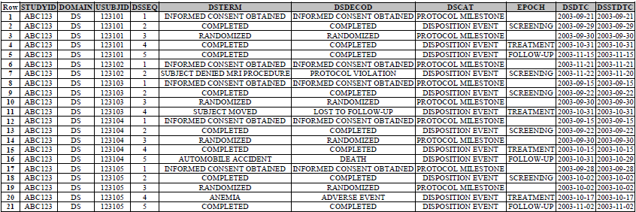
Knowledge Check
In which variable can you store Reason for study discontinuation added by investigator
Ans: DSTERM
In Disposition SDTM , how will you store the information about “Informed consent obtained”, subject discontinued due to AE
Ans:

Slide 25
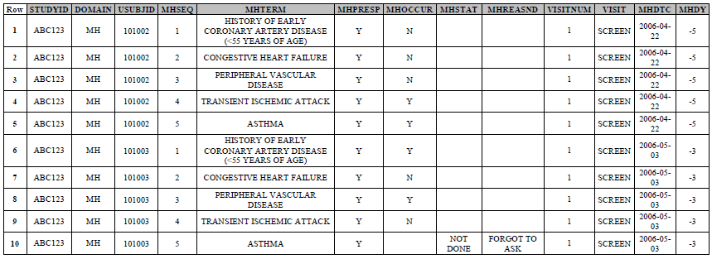
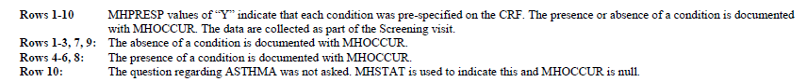
Knowledge Check
What are your observations based on the given data
Ans

Slide 26
References
SDTM IG 3.2
Notes:
Content Slide- 2 row / comparison

Slide 27
Thank You
For any feedback/comment/clarification please contact us at PALS@tcs.com
V NN

Slide 28
Document Release Notice
This XXXXXXX, Version NN, is released for use in Tata Consultancy Services (TCS) with effect from – DD-Mmm-YYYY.
This Training Material is subject to TCS Document Control Procedure. TCS reserves the right to make additions, modifications or alterations to the existing content or release a newer version of this document.
Softcopy of the latest version of the document is available in the ABCDEFG
Comments suggestions or queries should be addressed to PALS@tcs.com.
Date: DD-Mmm-YYYY
Date: DD-Mmm-YYYY
Document Name
Effective Date: DD-MMM-YYYY
V NN
Notes:
Font size 9pt

Slide 29
Change/Revision History
Version No. | Revision Description | Slide No. | Rationale for the Change | Change type (Add/Modify/Delete) | Modified By | Date Modified (DD-Mmm-YYYY)
V NN

